Slide 1
Form Validations
(HTML Level)

Slide 2
required (not empty)

Slide 3
DEMO

Slide 4
More on
radio buttons

Slide 5
Non <input> tag
dropdowns
textarea

Slide 6
DEMO

Slide 7
Forms
Exercise
(Registration Form)

Slide 8
Intro to CSS
(Cascading Style Sheets)

Slide 9


Slide 10
General Rule
selector {
property: value;
anotherproperty: value;
}

Slide 11
Example
h1 {
color: purple;
font-size: 36px;
}

Slide 12
Where do we
write our styles?

Slide 13
inline (bad)
style tag (bad)
link (great!)

Slide 14
DEMO

Slide 15
CSS Selectors

Slide 16
Basic Selectors

Slide 17
Type Selector
elementName

Slide 18
Class Selector
.className

Slide 19
ID Selector
#idName

Slide 20
Universal Selector
*

Slide 21
Attribute Selector
[attr=value]

Slide 22
Combinator Selectors

Slide 23
Adjacent Sibling
Combinator
A + B

Slide 24
General Sibling
Combinator
A ~ B

Slide 25
Direct Child
Combinator
A > B

Slide 26
Descendant
Combinator
A B

Slide 27
Grouping
Combinator
A, B

Slide 28
DEMO

Slide 29
Pseudo-
Classes
(Common only)

Slide 30
:first-child
:last-child
:nth-child()

Slide 31
DEMO

Slide 32
Pseudo-
Elements
(Common only)

Slide 33
::after
::before
::first-line
::first-letter

Slide 34
DEMO

Slide 35
CSS Properties
(There’s a lot!)

Slide 36
Colors
color: #123ABC;
#hexadecimal
rgb(125,255,15)
rgba(125,255,15,0.5)

Slide 37
DEMO

Slide 38
Background
background: #abc;

Slide 39
DEMO

Slide 40
Borders
border: 1px solid black;

Slide 41
border: 1px solid black;
border-radius: 8px;
box-shadow: 2px 2px 2px #000;

Slide 42
DEMO

Slide 43
Fonts
(common only)

Slide 44
font-family: ‘Arial’,’ serif’;
font-size: 1.25em;
font-style: italic;

Slide 45
DEMO

Slide 46
Texts
(common only)

Slide 47
text-indent: 12px;
text-align: center;
text-decoration: underline;

Slide 48
text-shadow: 2px 3px 6px red;
text-transform: lowercase;
word-spacing: 5px;

Slide 49
DEMO

Slide 50
Lists
(common only)

Slide 51
list-style: lower-roman;

Slide 52
Table
(common only)

Slide 53
border-collapse: collapse;

Slide 54
DEMO

Slide 55
Line Box
(common only)

Slide 56
line-height: 1.25;
vertical-align: super;

Slide 57
DEMO

Slide 58
Box Model
(!important)

Slide 59
display: block;
height: 50px;
width: 50px;

Slide 60
margin: 20px;
padding: 20px;
overflow: visible;
visibility: hidden;

Slide 61
float: left;
clear: both;

Slide 62
DEMO

Slide 63
Positioning
(!important)

Slide 64
position: absolute;
left: 5px;
right: 5px;
top: 5px;
bottom: 5px;
z-index: 1;

Slide 65
DEMO

Slide 66
CSS Specificity
(More Specific = Higher Priority)

Slide 67
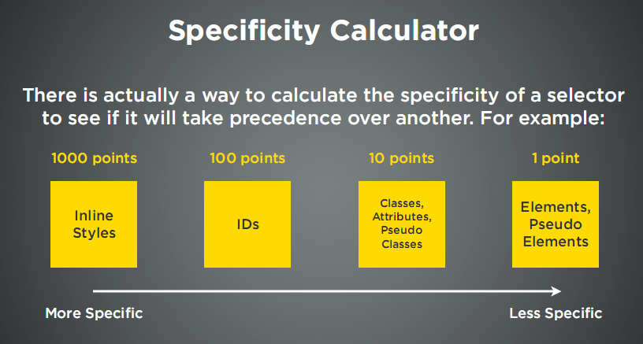

Slide 68
DEMO

